Slide 1
EDUCATION IN DANGER INCIDENTS: ANALYZING SCHOOLS AND UNIVERSITIES ATTACKS IN WAR AND CONFLICTED AREAS AND THE EFFECTS ON STUDENTS, CHILDREN AND EDUCATORS
THY PHAN FINAL PRESENTATION – AIT 580-004

Slide 2
Dataset
The dataset, named 2020-2024 Education-in- danger-incident-data, was taken from the Humanitarian Data Exchange website and contributed by Insecurity Insight.
Contains detailed records on number of schools and universities attacks, number of students and educators have been injured, kidnapped and killed across different countries and different locations and event descriptions of these incidents.
Ranged from January 1, 2020, to September 15, 2024, and has all four data types: nominal, ordinal, interval and ratio.
My interest in this topic comes from a deep desire to understand global crises and advocate for what is right. By analyzing this dataset, I aim to uncover the importance of education to humans and the challenges faced by vulnerable populations, particularly those affected by conflict and displacement.

Slide 3
Methods
Using Python to clean data, analyze number of students got attacked over years, top five countries have highest incidents.
Using R to examine Geo Precisions Levels, Clustering of number of students injured, attacked, etc. with latitudes and longitudes and display visualizations.
Using SQL to display top five countries with highest students killed, injured, countries with high sexual violence events and analyze dates and months have the highest attacks over years.
Using Python to visualize months with highest incidents over years and perform Sentiment Analysis - NLP for events descriptions of every incidents of the dataset.

Slide 4
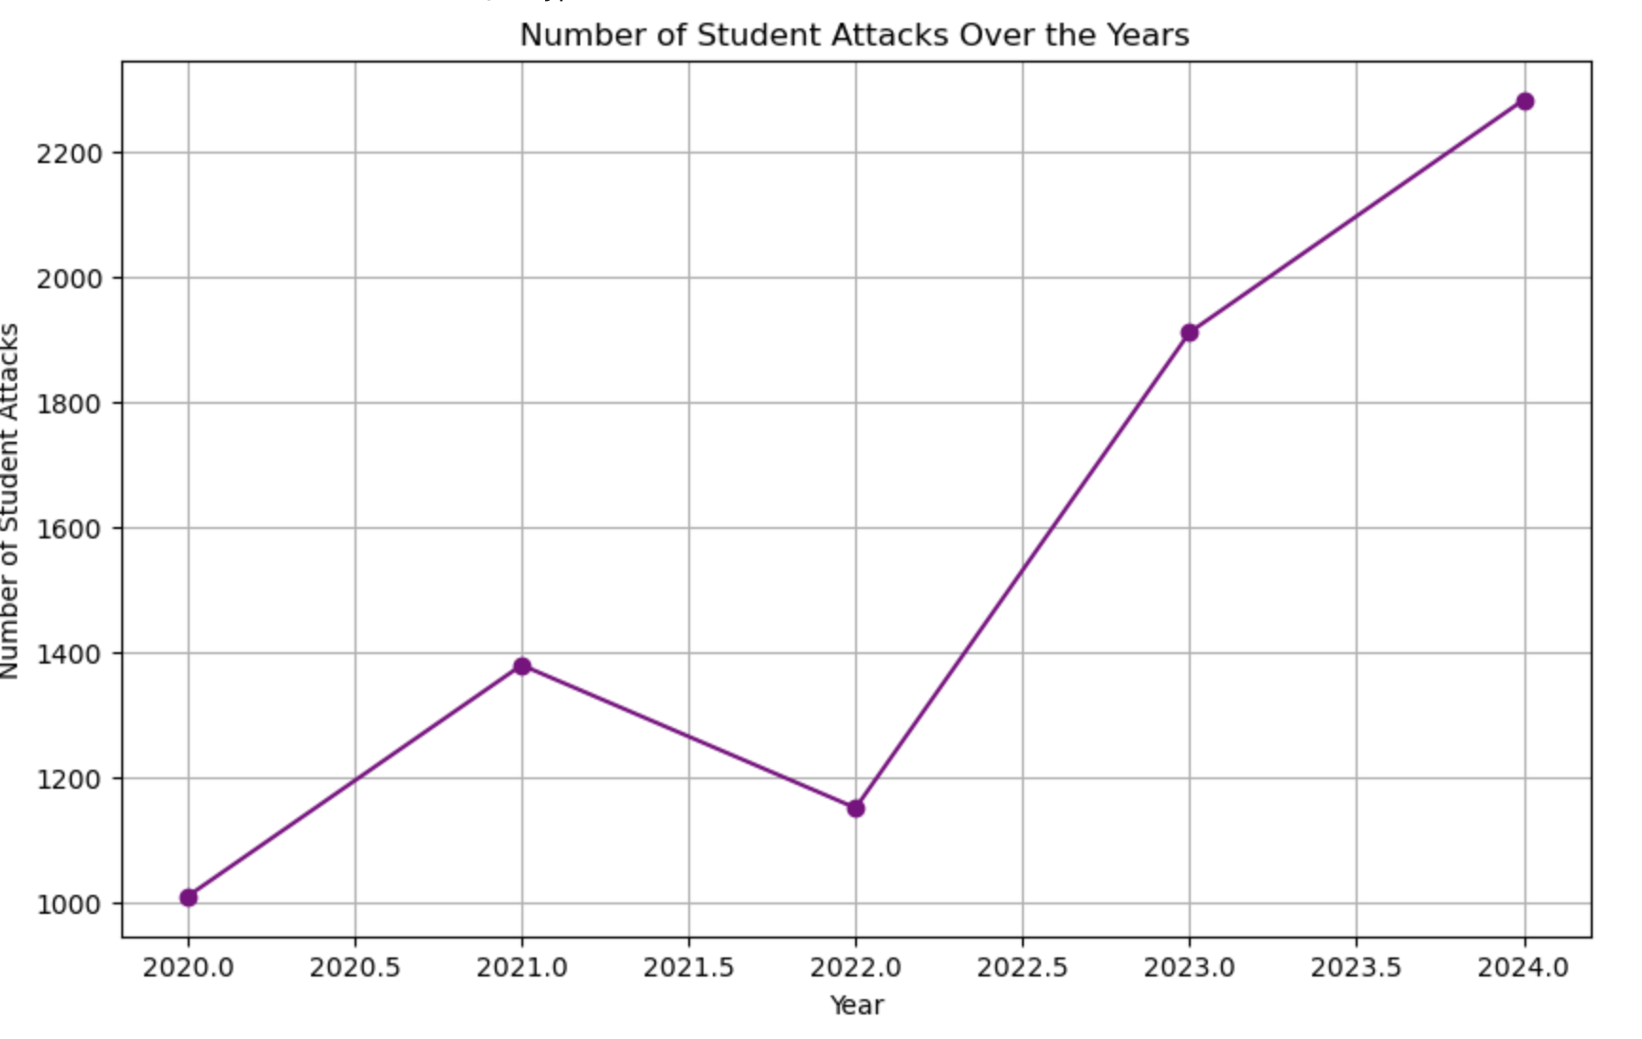
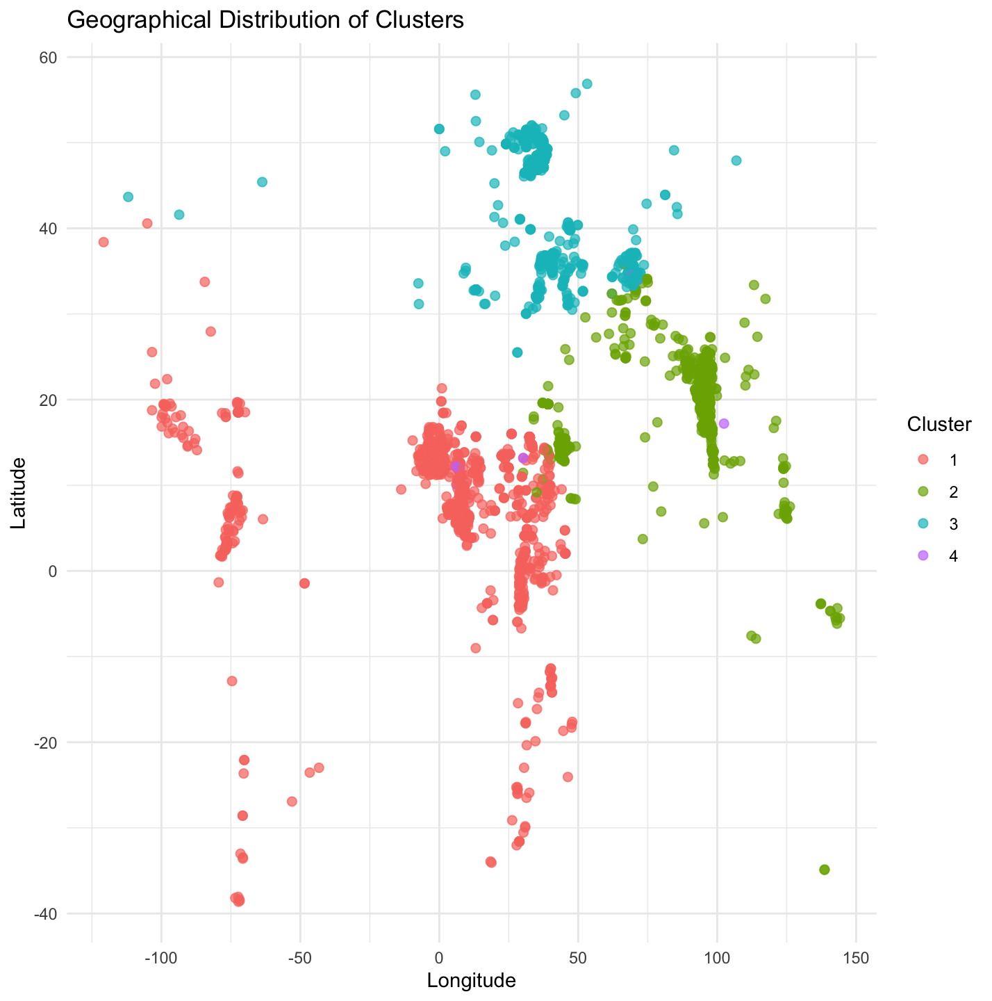
Results
Number of students attacked have increased significantly over years.
Geographical distribution of clusters 1,2,3,4 of number of students killed, injured, attacked and total sexual violence cases.

Slide 5
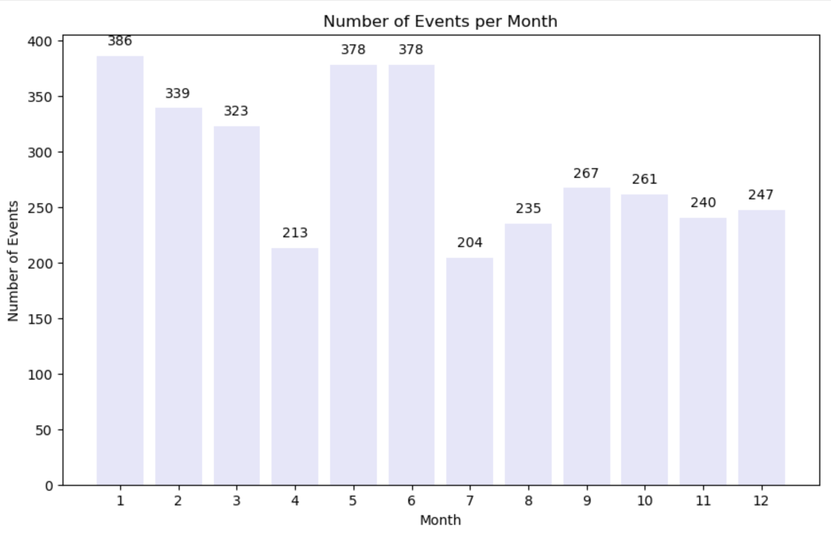
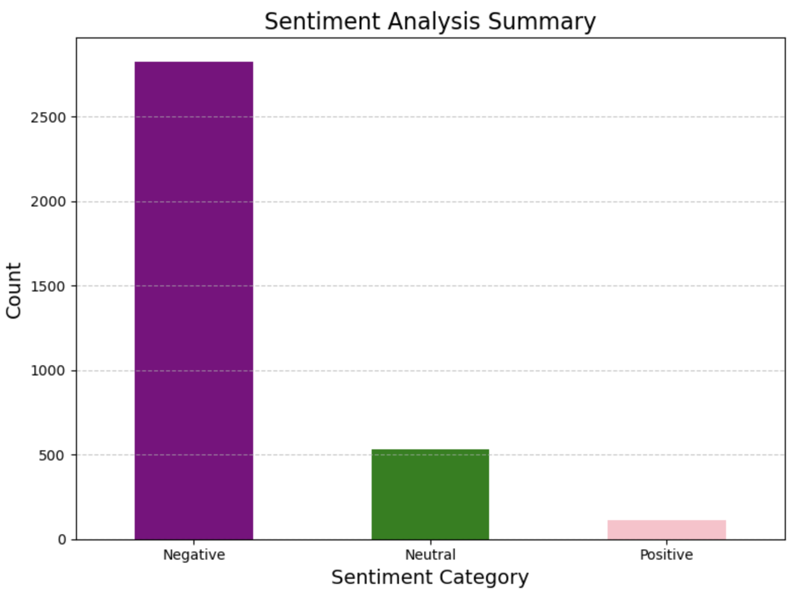
Results
January was the month with the highest number of attacks, and July was the month with the smallest attacks over years.
The sentiment analysis of Event Description resulted in the high frequency of negative responses.

Slide 6
Lessons
I enhanced my knowledge in using R, Python and SQL to analyze dataset.
I increased my understanding in writing research paper in IEEE format.

